Slide 1
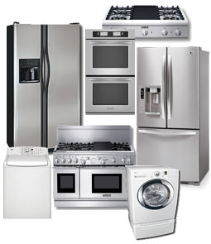
DURABLEGOODS
PANEL DATA ANALYSIS
AYUSHI CHOUDHARY
RITUMBHRA SAGAR
SHILPA CHOTWANI
SONAL AGRAWAL

Slide 2
DATA DESCRIPTION
Dataset includes
Key variables of interest
Panel Date; 19,936 households with 173,262 transactions
From December 1998 to November 2004
292 product categories , including:
- Big ticket items televisions, cameras, and PDAs
- Small ticket items CDs, batteries and accessories
Demographics
Age
Gender
Children
Income
Product
Category
Price
Transaction
Month
Year
Online Trans
Summary

Slide 3
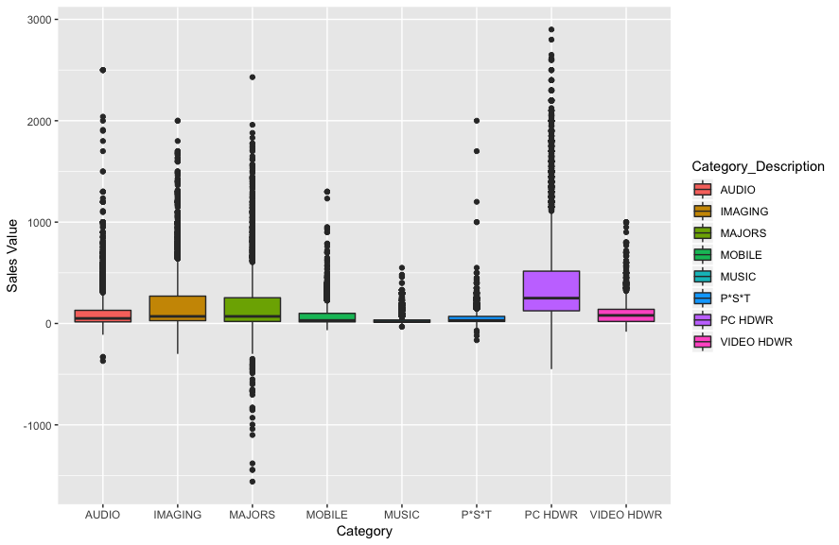
DATA DESCRIPTION
Unit Price for Product Category
Notes:
We did some exploratory analysis to understand our data better:
Type 1 transaction i.e. Purchase had maximum number of transactions, which makes sense (followed by Returns, Service based Purchases)
The graph depicts the unique transactions for each Income group ranging from 1 to 9. The number of unique transactions for Income group 6 is the highest (~8200) and Income group 2 is the lowest(~1000)
The graph shows prices across product categories, with PC- HWDR (PC Hardware), Majors (Home appliances like refrigerator, microwave etc.) being highest priced categories compared to others.

Slide 4
BUSINESS OBJECTIVES
Identify Key Customers using Behavioral Segmentation
Based on past purchase behaviors.
Predicting Customer Return Behavior
Based on customer’s demographic profile and product categories.

Slide 5
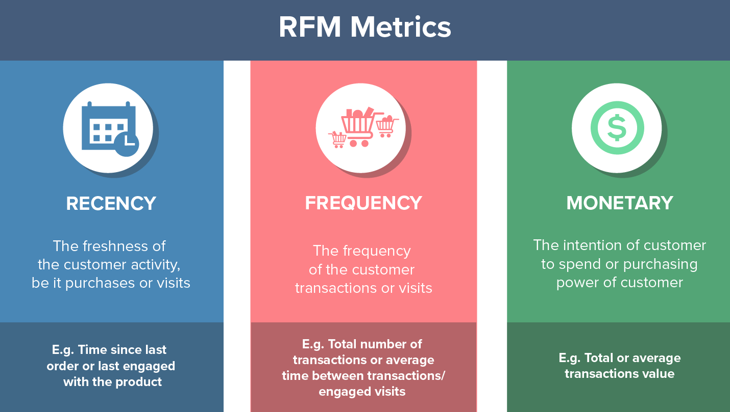
SEGMENTATION USING RFM ANALYSIS
Why RFM ?
Behavior-based
Focuses on Past Purchase transactions
What is RFM ?
RFM Score
Quantile score
1 – Most recent
4 – Least recent
Quantile score
1 – Most Frequent
4 – Least Frequent
Quantile score
1 – High Value
4 – Low Value

Slide 6
RFM SCORE CALCULATION
Difference between a ‘Reference Date’ (Last Date Observation in the dataset) and the ‘Last Purchase Date’ for each household. This score was then converted into a score ranging from 1-4 after normalization.
Number of transactions i.e. ‘Number of Unique Invoices’ for each household during the period of relationship with the company. This score was then converted into a score ranging from 1-4 after normalization.
‘Amount spend’ for each household during the period of relationship with the company. This score was then converted into a score ranging from 1-4 after normalization.

Slide 7
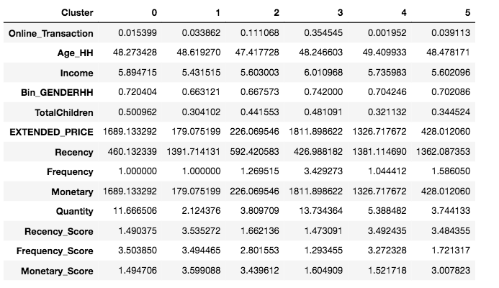
SEGMENTATION USING RFM BEHAVIOR ANALYSIS
K-Means Clustering
Panel Data converted to Cross Sectional Data on Household ID for RFM analysis
Optimal K = 6, based on Silhouette Score
3-Loyal High Value have high income and highest online transactions
0-Infrequent High Value have high income and do not shop online and have comparatively more children
4-Churned High Value have slightly higher income and lowest online transactions
2-Infrequent Low Value have moderate income and also have children and also shop online
No. of Households
2078
4607
2575
5500
2049
3068

Slide 8
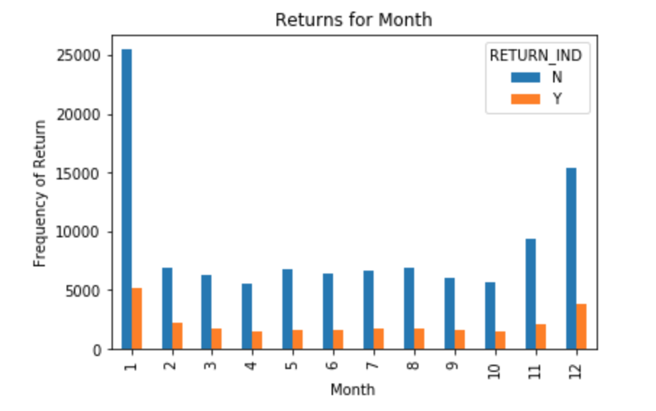
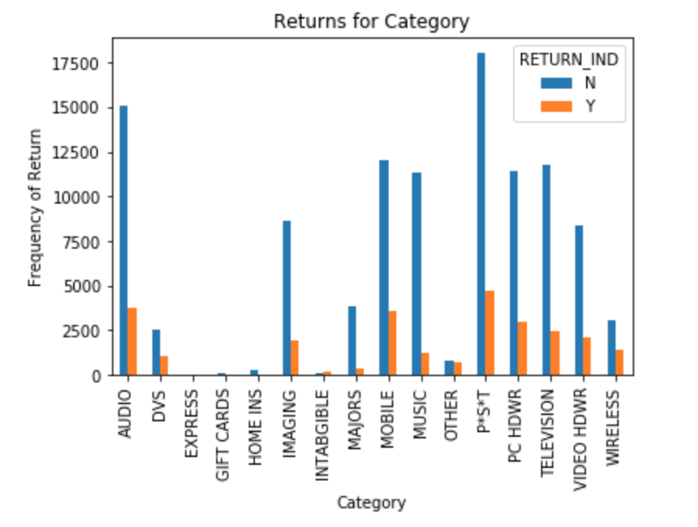
CUSTOMER RETURN BEHAVIOR
Returns account for 10.06% of the total Purchase Transactions.
(10729 returns vs. 106631 total purchase transactions)
Imbalanced dataset solved using oversampling
Month Fixed Effects
Category Fixed Effects
Maximum returns can be seen in January and December
Maximum returns can be seen in categories like: Audio, Mobile, PST

Slide 9
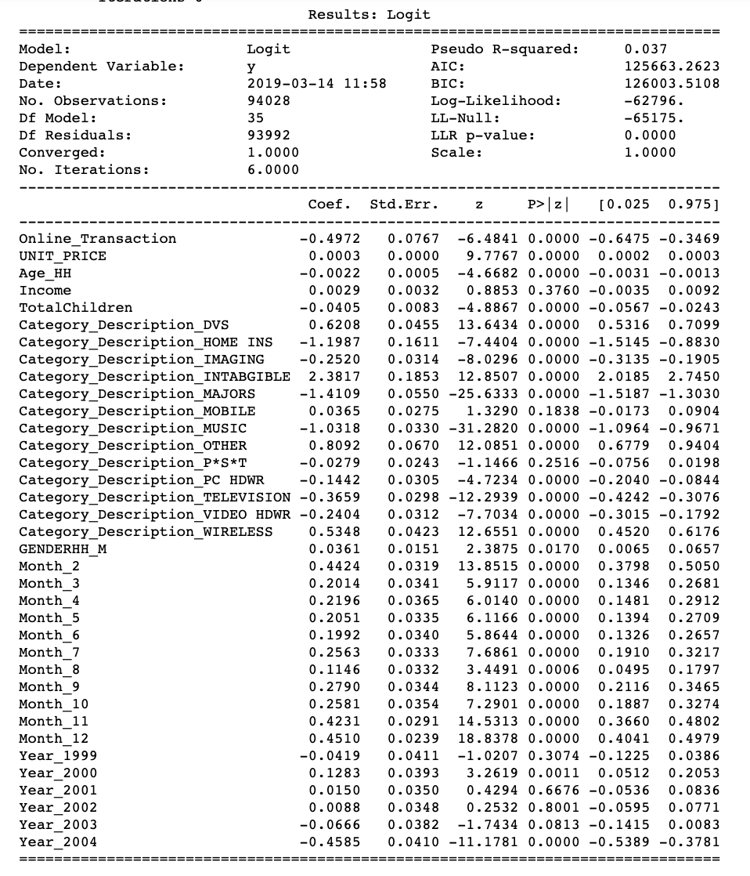
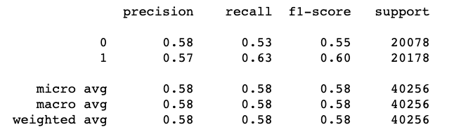
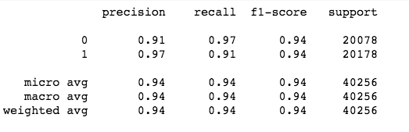
PREDICTING CUSTOMER RETURN BEHAVIOR
Logit Regression Results
Logit Regression Validation Score
Random Forest Validation Score
AUC Score
Logit | Random Forest
0.603 | 0.9608
Random forest vs.
Logit regression
Random Forest with higher AUC Score and predicted variables of importance is considered as a better predictor for return behavior

Slide 10
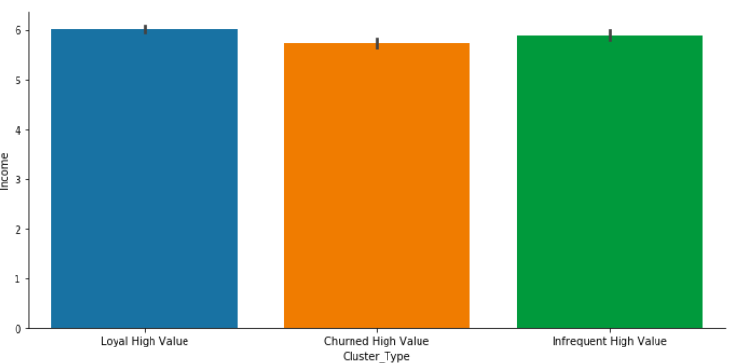
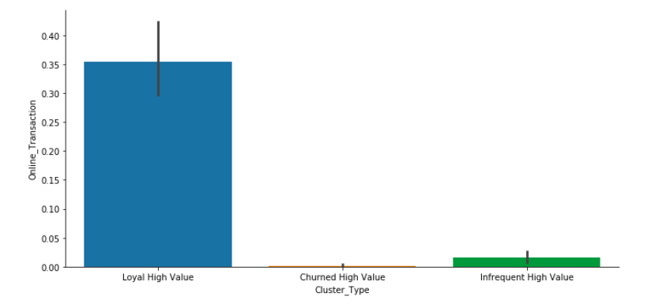
RECOMMENDATIONS – CUSTOMER SEGMENTATION
Income across Cluster
Online transactions across Clusters
3-Loyal High Value
0-Infrequent High Value
4-Churned High Value
2-Infrequent Low Value
3
4
0
3
4
0
Target Churned High Value Customers (Cluster 4) with promos and offers
Target cluster 0 and 4 with sign-up discounts and online offers, to drive more online sales.

Slide 11
RECOMMENDATIONS – PREDICTING RETURNS
Returns can be predicted based
on Importance Scores
Key Variables of high importance (in order):
Unit Price
Gender
Age
Income
Number of Children
Product Categories of high importance:
P*S*T (Scooter)
Television
Music

Slide 12
LIMITATIONS
Limited covariates to predict returns. For example: Details about return policy, product ratings etc.
Dataset does not contain information on non-price-related promotions.
(TV advertising, catalogs, store displays, etc. )
Data is from a single retailer. Without information on consumer purchases from other retail outlets, studies on some consumers decisions such as product adoption, upgrade, and replacement could be subject to bias.
Dataset includes maximum transactions for purchases hence, any analysis on data is skewed towards purchases.

Slide 13
THANKYOU

Slide 14
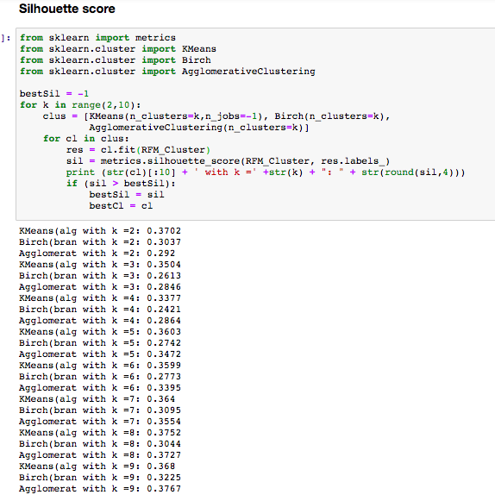
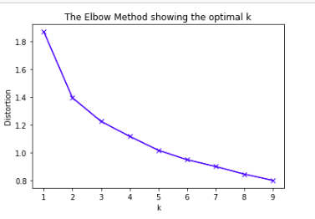
APPENDIX
Finding the optimal clusters

Slide 15
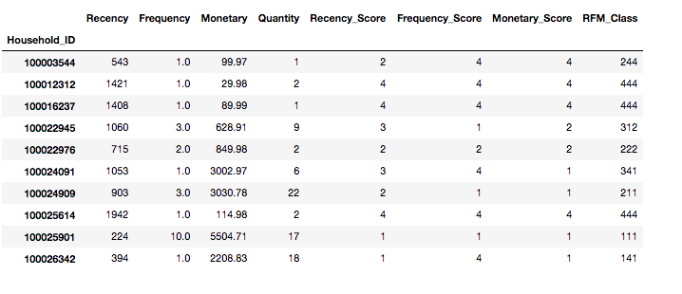
APPENDIX
Snapshot of Recency, Frequency, Monetary Score and RFM Class for each household ID

Slide 16
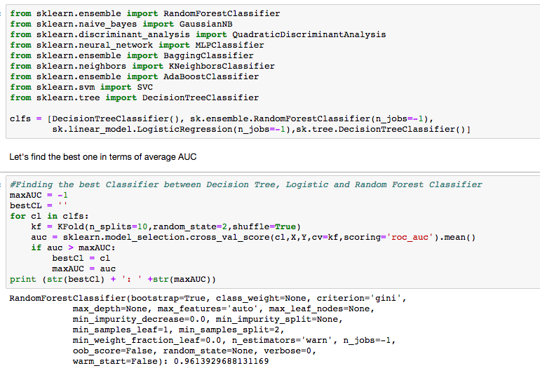
Finding best classifier
Result: Random Forest

